Slide 1
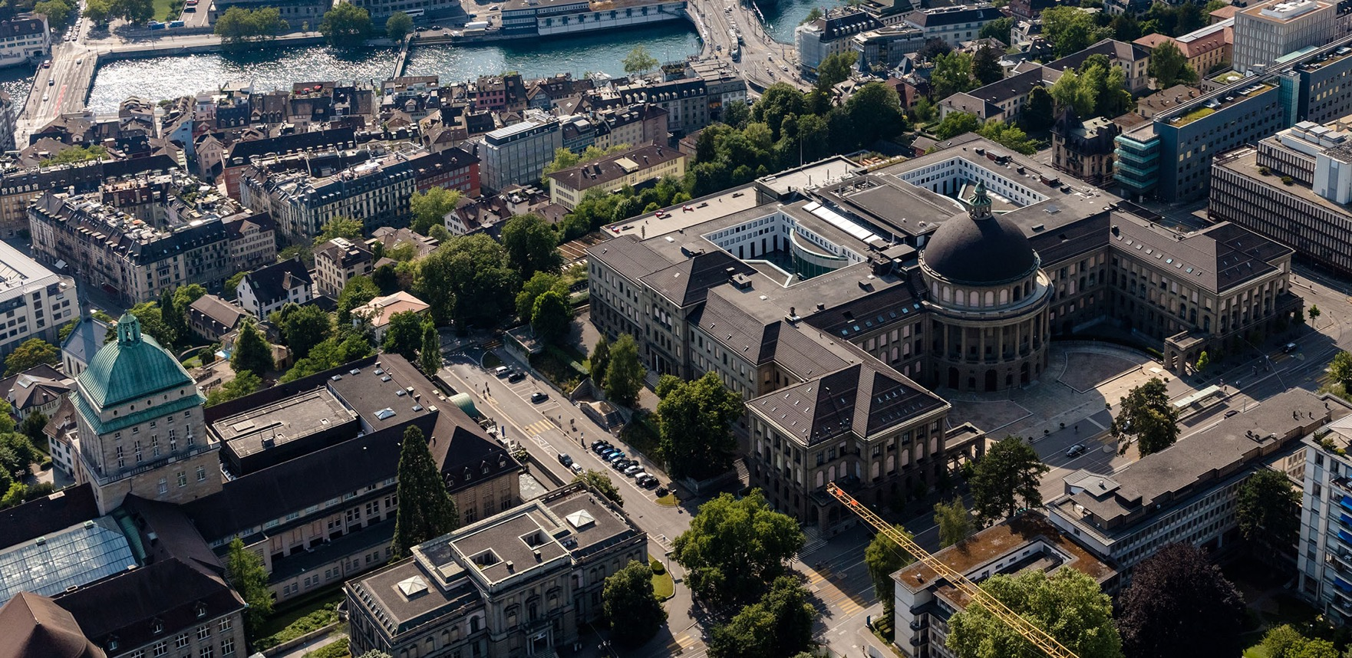
Trusted Research Environments for Handling Sensitive Data in Research: a Swiss Experience and Perspective
IT Services
Dr. Sergio Maffioletti
Scientific IT Services / ETH

Slide 2
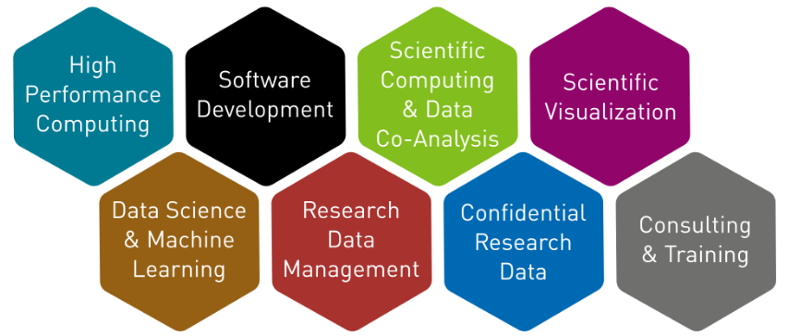
Scientific IT Services @ ETH
A section of ETH Zurich IT Services - https://sis.id.ethz.ch/
About 45 experts in various areas of scientific computing
With a background in different areas of science

Slide 3
What questions are we going to address ?
What is a Trusted Research Environment (TRE) and what purpose it serves in academic research ?
Why Switzerland needs a Swiss Trusted Research Environment for research ?
How academic research usecases are enabled on a versatile TRE ?
What challenges one has to face when building a TRE service ?

Slide 4
What questions are we going to address ?
What is a Trusted Research Environment (TRE) and what purpose it serves in academic research ?
Why Switzerland needs a Swiss Trusted Research Environment for research ?
How academic research usecases are enabled on a versatile TRE ?
What challenges one has to face when building a TRE service ?

Slide 5
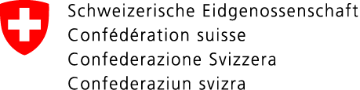
De-identification
A Guide for technical and organizational measures
The Federal Data Protection and Information Commissioner (FDPIC) 2015
IF concordance table exists, data are NOT anonymous
Pseudonymization: identifying information is replaced by a code (e.g. concordance table) only accessible with a “key” under strict security regulations
Strictly Confidential Data
Identifyable
Pseudonymized (Coded)
Anonymized
Oscar Smith
13.03.1973
USZmU23a1Ihxuq6z
Someone
Broke his left leg while skiing
Broke his left leg while skiing
Broke his left leg while skiing
Concordance table
Code | First Name, Last Name
USZmU23a1Ihxuq6z | Oscar, Smith
EnCt2536869affba49344ef01b24c2d1311782ae6a881536869affba49344ef01b24ch/F6hVeLgQCdzJeg7lt0PHsLwbggXtcuaIxRTNOTduyn8iCJVem/1loEuPtkCQ==IwEmS
Encrypted

Slide 6




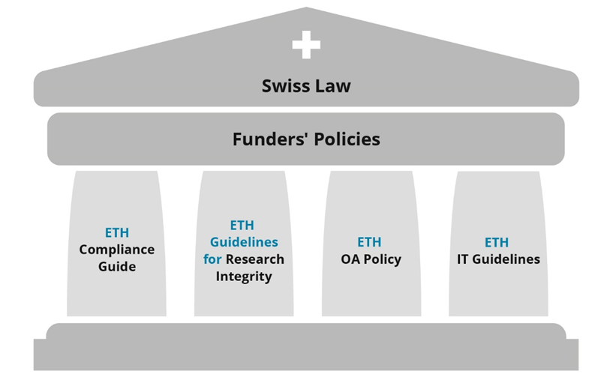
Vectors in working with sensitive research data
Working with…
… requires
^{Analysis}
Sensitive research data
^{Confidentiality}
Data Transfer
Agreements
^{Development}
^{Access}
^{Availability}
^{Integrity}
^{Data}
^{Transfer}
^{Compliance}
^{Documentation}
Research expertise
Legal and Security compliance
Notes:
Legal compliance:
Challenge Sensitive data has to be legally compliant, and the applicable law depends on the nature and source of data.
Impact Classification of data is elaborate,not classyfing data presents a considerable risk and has a long-term impact of eroding trust on entire research community from data sources (like patients).
Solution Put the data in a secure space, not only for storage and archiving but for processing too.
Demonstrable intactness: when working with sensitive data, one has to be able to prove that it has not be unlawfully altered.
Establishing a full traceability is a lot of effort and therefore often does not get fully done. The full trust that data and algorithms are not tamper-free is not given.
The security management has to log not only access, but data transfers, user activity and metadata modifications. This has to be integrated in the reserach environment.
Reliable data exchange: when using third party data, the source has to be trusted and compliance to data protection laws has to be provable.
When «forgetting» the compliance process for importing or exporting data, the research result can be compromised or even be retired from publication.
In parallel to a secured storage and computing environment, the required legal framework is built and offered as fully integrated and non circumventable process.
Generate reproducible research results: the paper-based publication method is continued even when digitalized.
When publishing results, the method and algorithms are complicated to repeat by the audience if the source data and software is not joined to the publication.
By using Jupyter notebooks, the full (anonymized!) data set and the algorithms can be published and the research can be fully validated by peers.
Avoiding the path of least resistance: it is always tempting to built quick ad-hoc solutions in a specific research environment
Legal and reputation risk in case of leakeage, missing trust in results if data gets altered, inefficient because re-inventiung the wheel for every project.
Adhere to a standardized envirornment built for handling sensitive research data.
6

Slide 7
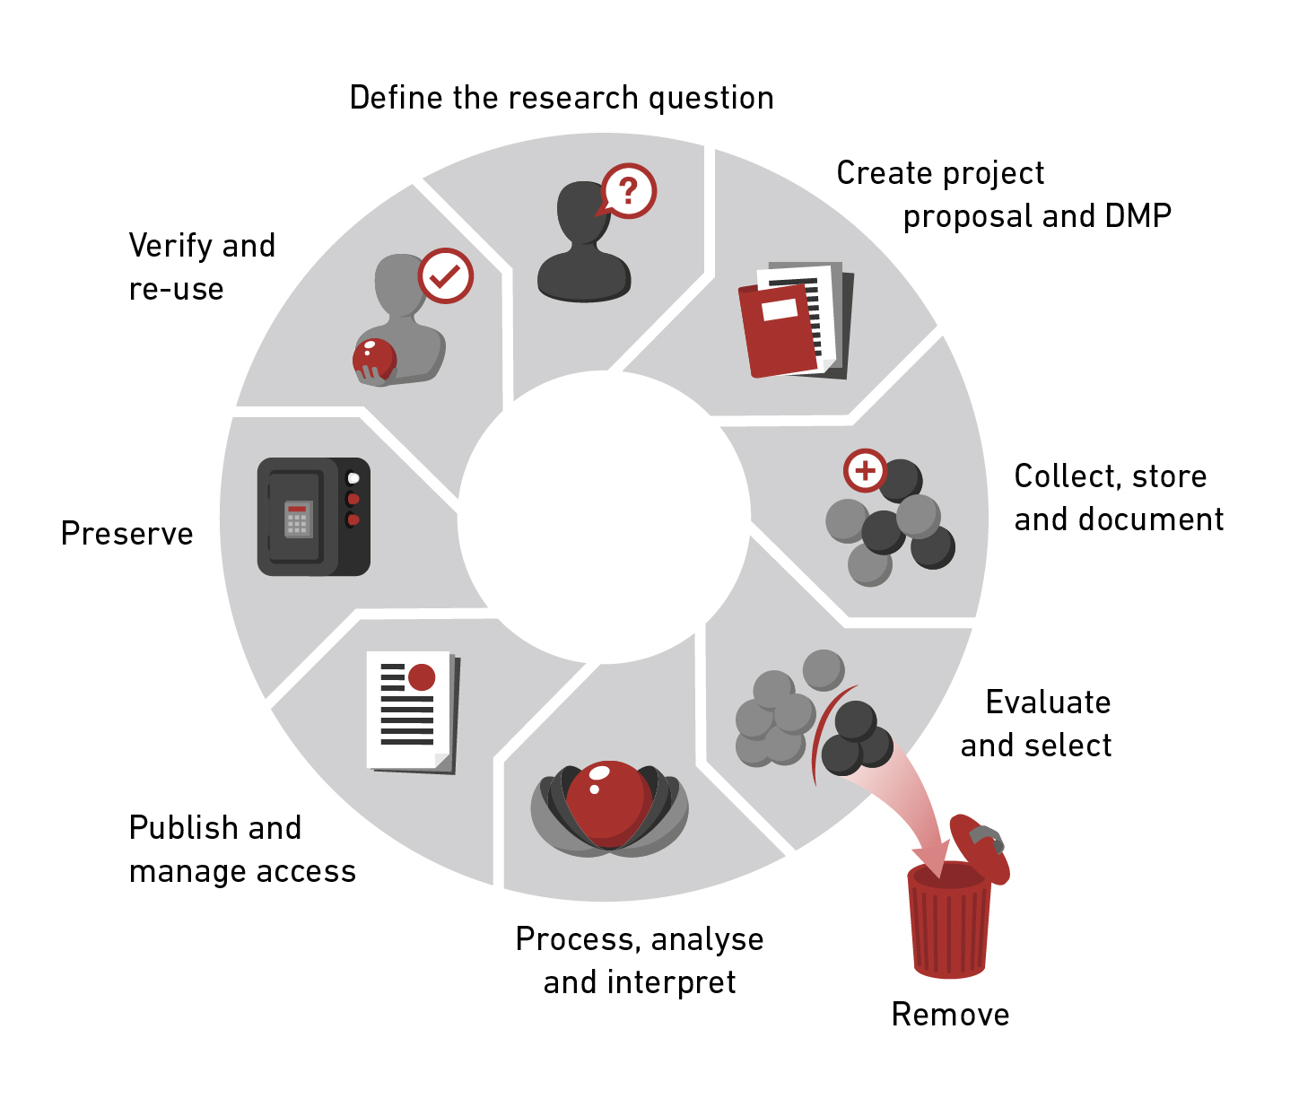

Sensitive data requires specific measures
Secure environment
CC BY 4.0, Andres Bucher
Conclusion: there is a need for a specific environment for working with this data which ensures the technical and organizational abilities – they are called a Trusted Research Environment (TRE).
7
Notes:
In case of confidential and strictly confidential data: special measures for all parts of data life cycle are needed
One solution is a secure environment where both data itself and data processing is protected
These measures have the purpose to ensure confidentiality of information and protect privacy of persons

Slide 8
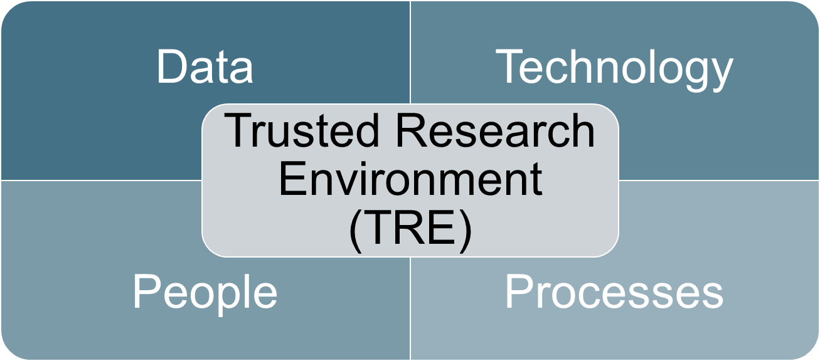
Leonhard Med (LeoMed) is a Trusted Research Environment (TRE) hosted and operated by ETH to support Swiss academic research
A Trusted Research Environment (TRE) is a secure, controlled platform that facilitates the safe use of sensitive data for academic research.
It ensures that data is accessed, processed, and analyzed in a manner that upholds privacy, security, and compliance with regulatory requirements;
enabling researchers to conduct high-quality research while protecting sensitive information.

Slide 9
What questions are we going to address ?
What is a Trusted Research Environment (TRE) and what purpose it serves in academic research ?
Why Switzerland needs a Swiss Trusted Research Environment for research ?
How academic research usecases are enabled on a versatile TRE ?
What challenges one has to face when building a TRE service ?

Slide 10
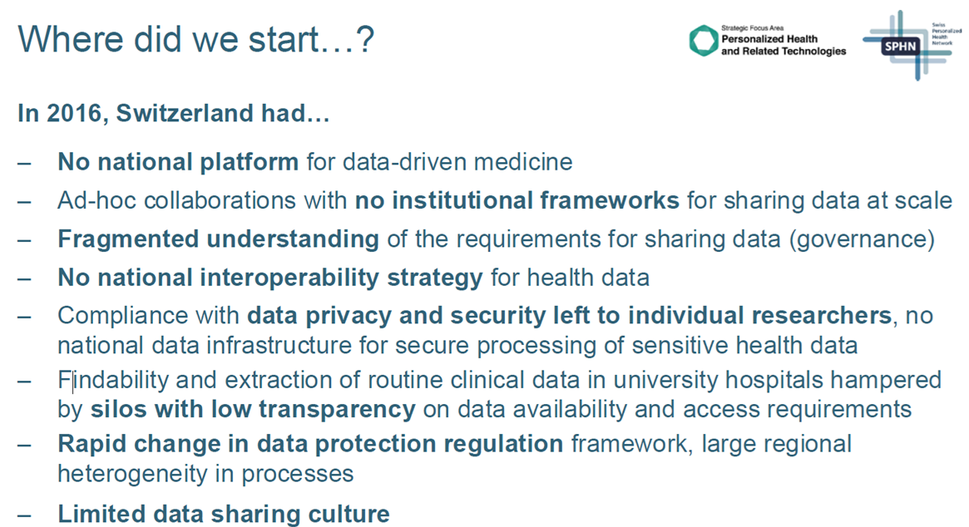
Slide courtesy of SPHN and PHRT. Presented at the “Data for Health Symposium” 31.10.2024

Slide 11



SPHN, PHRT, LOOP: complementary federal and cantonal initiatives
Swiss Programs for Personalized Health Research
Mandate by SERI to SAMS and SIB
Goal: establish an infrastructure for the nation-wide use of health data for research
Strategic focus area of ETH/EPF Doamin
Goal: drive the ongoing life science revolution that will ultimately transform medicine as it is today into 'individualized medicine'.
Translational research center in Zurich

Slide 12
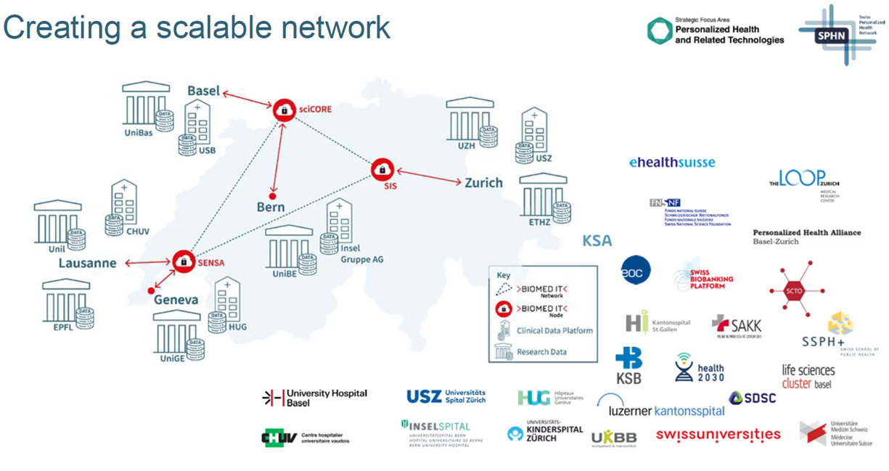
Slide courtesy of SPHN and PHRT. Presented at the “Data for Health Symposium” 31.10.2024

Slide 13
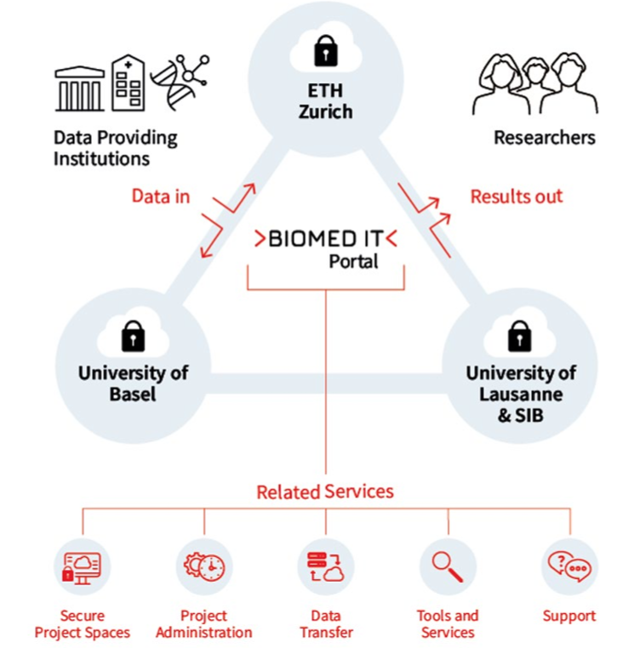
BioMedIT: Switzerland’s Trusted Research Environment Ecosystem
Integral part of SPHN since 2017
Secure Cloud & HPC
3 x nodes + 1 x Central coordination (DCC)
1 x Information security policy.

Slide 14
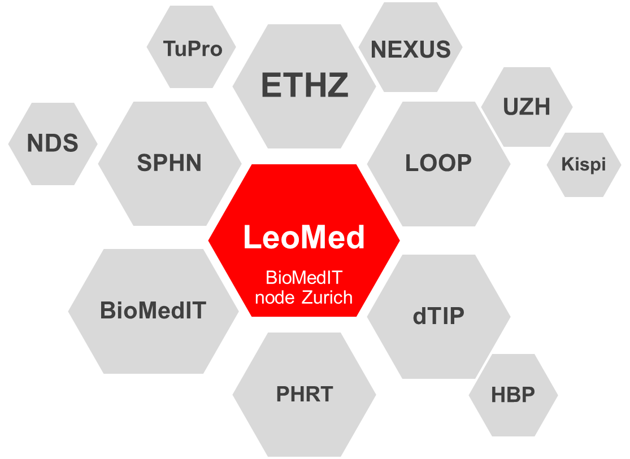

Leonhard Med: supports researchers at the forefront of Swiss personalized health research
Since 2017, Leonhard Med is at the heart of many Swis-wide programs for Personalized Health Research
FEGA

Slide 15
What questions are we going to address ?
What is a Trusted Research Environment (TRE) and what purpose it serves in academic research ?
Why Switzerland needs a Swiss Trusted Research Environment for research ?
How academic research usecases are enabled on a versatile TRE ?
What challenges one has to face when building a TRE service ?

Slide 16
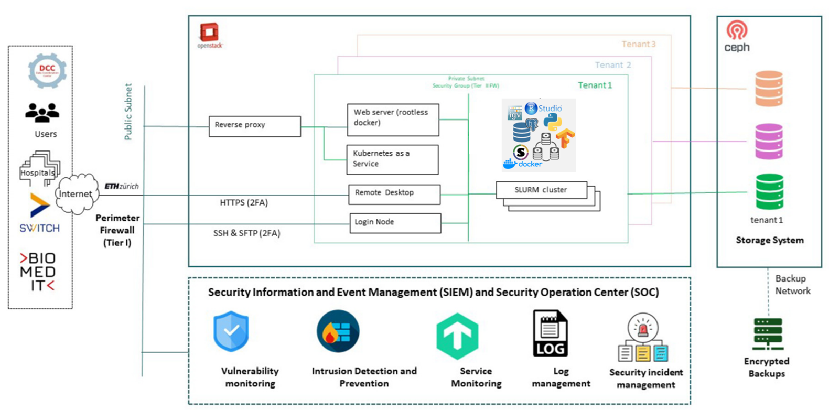
Anatomy of a LeoMed tenant

Slide 17

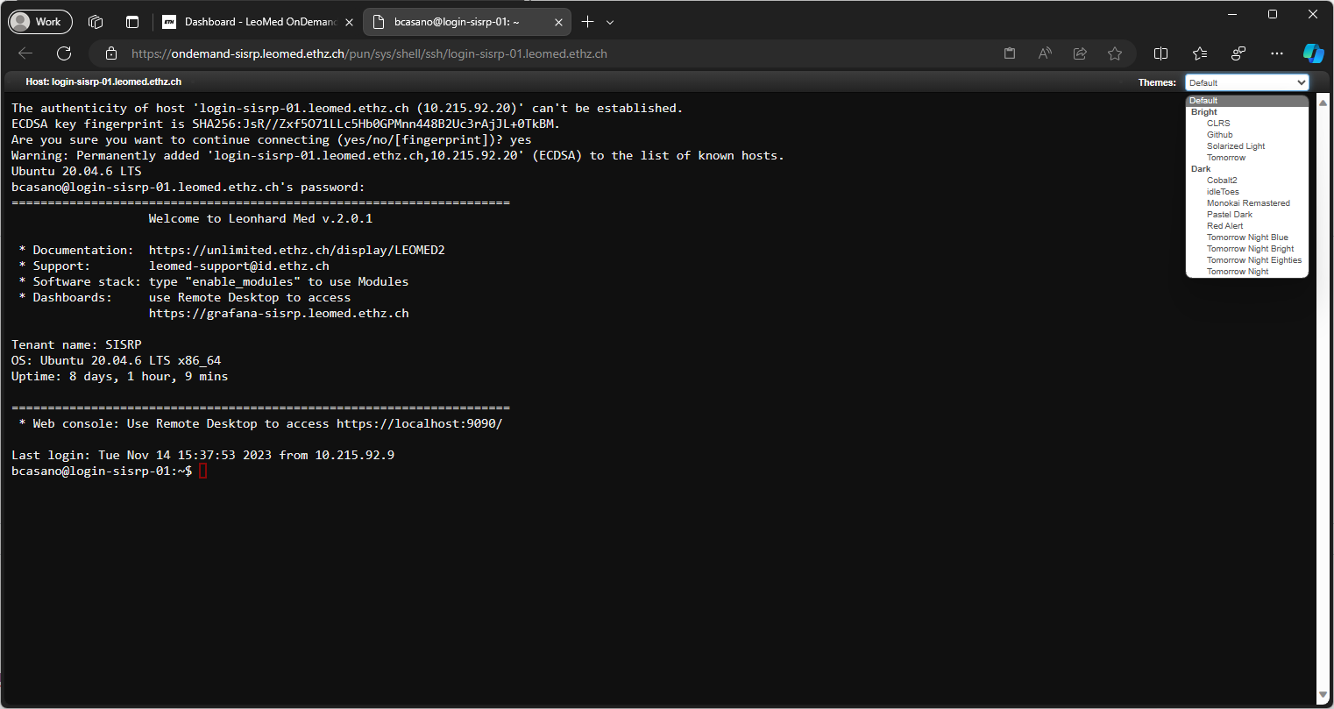
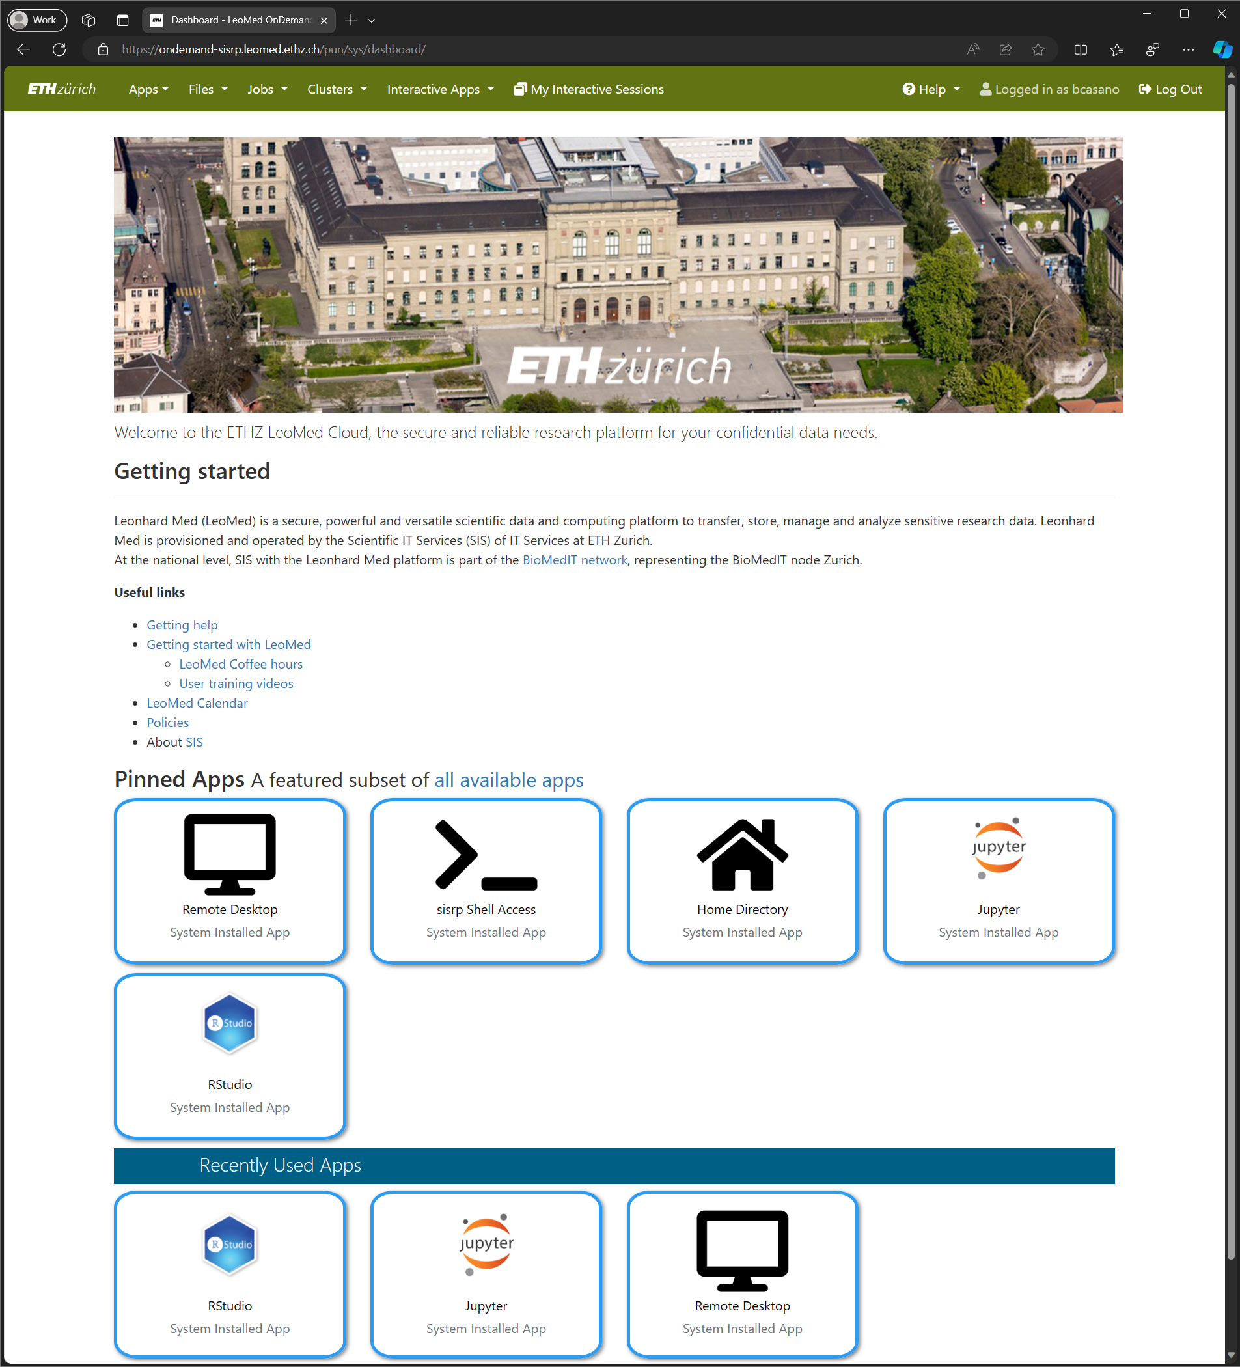
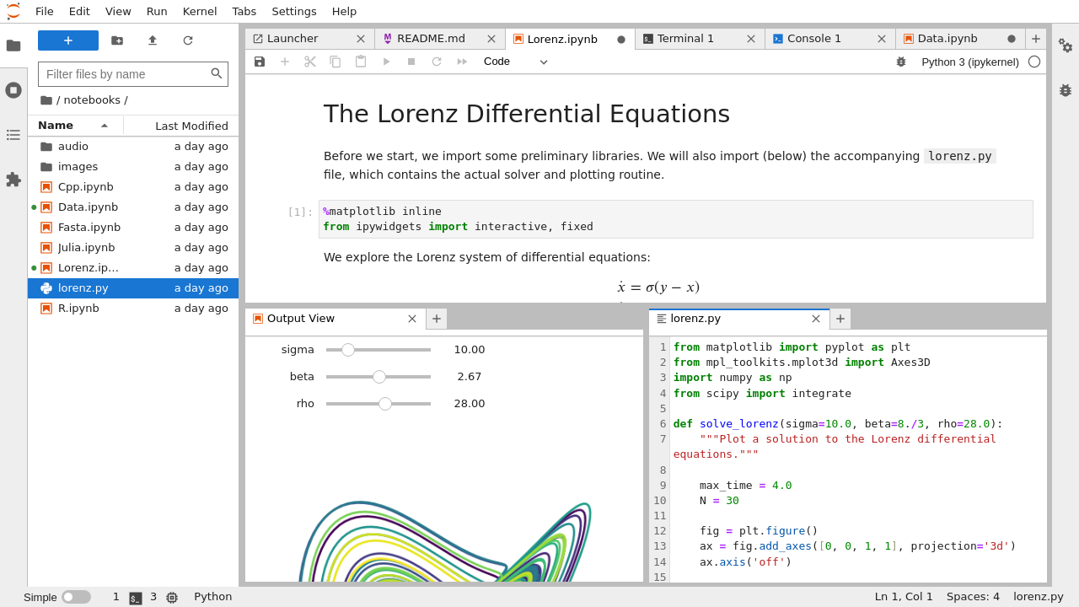

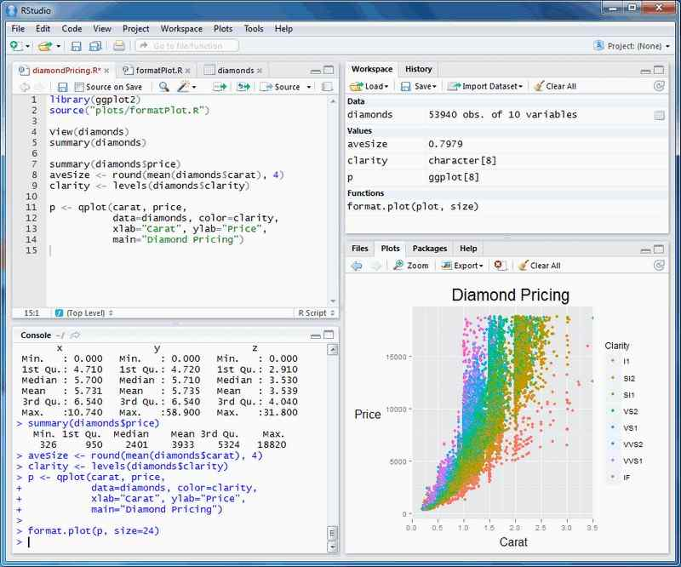






17

Slide 18

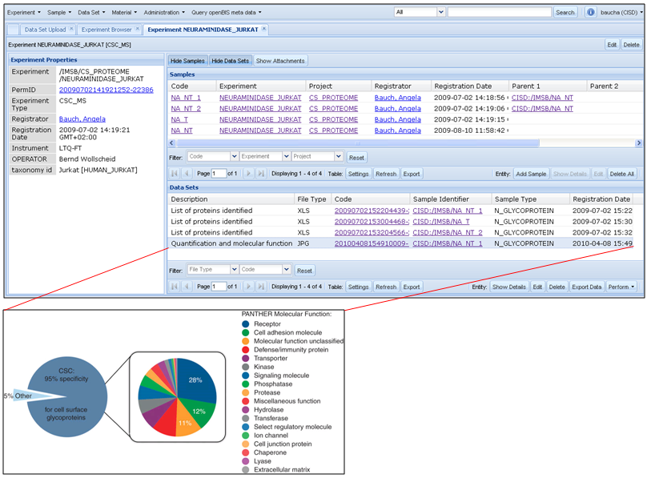
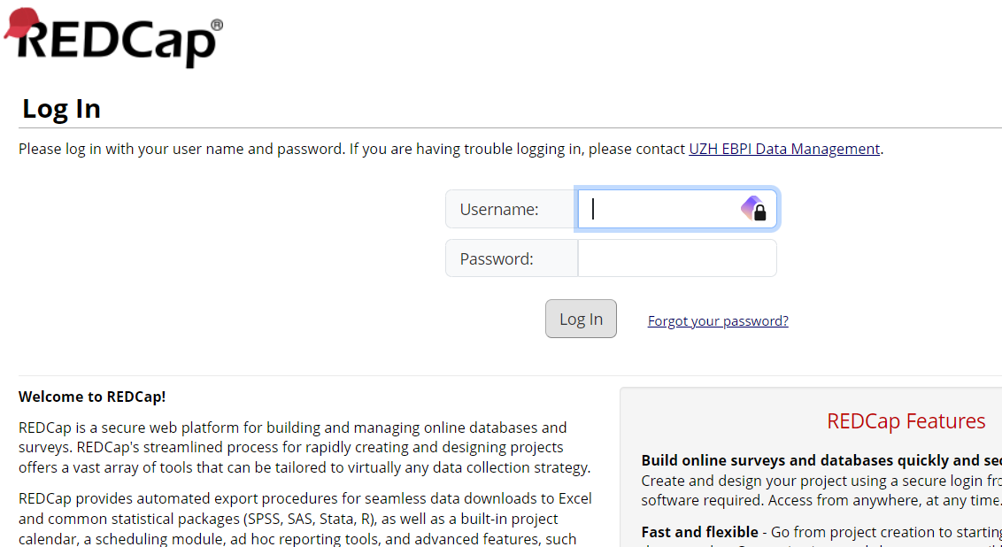
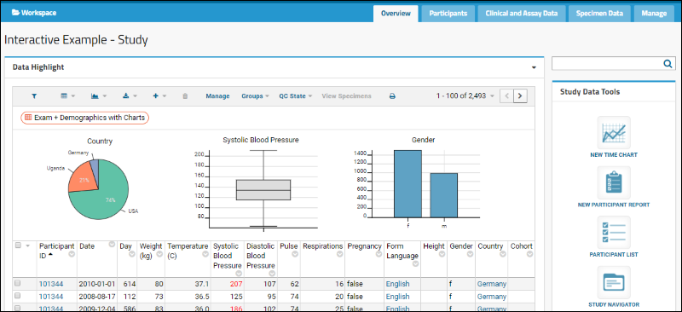
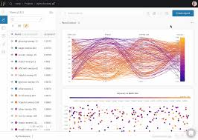



Slide 19
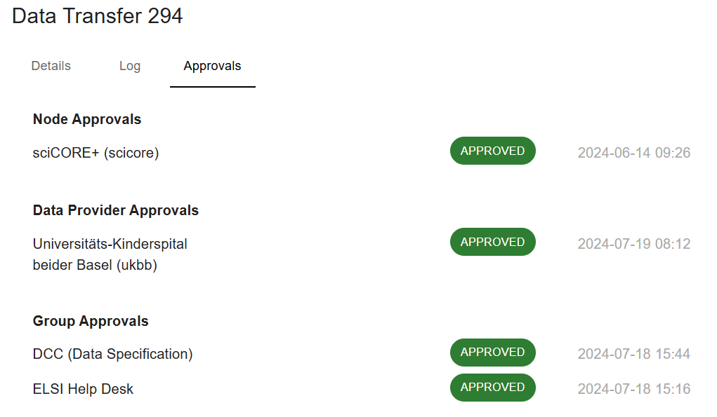
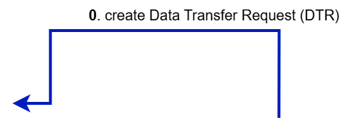
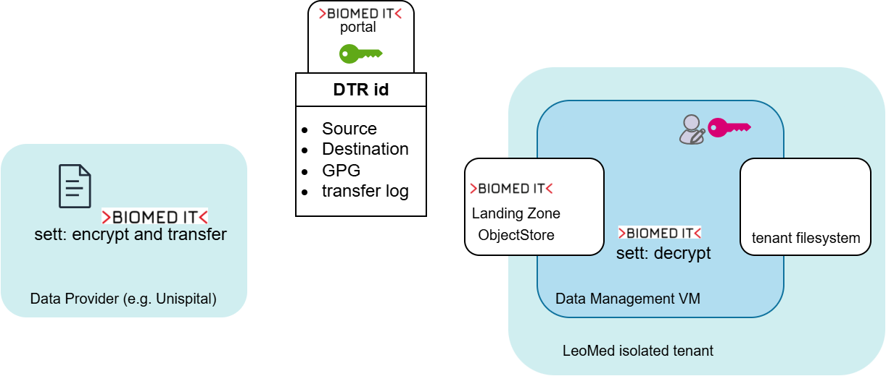
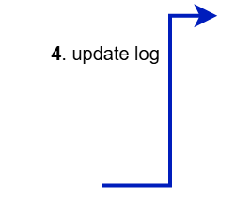
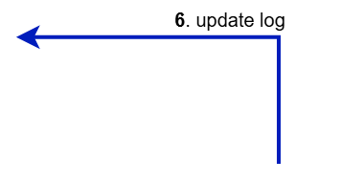
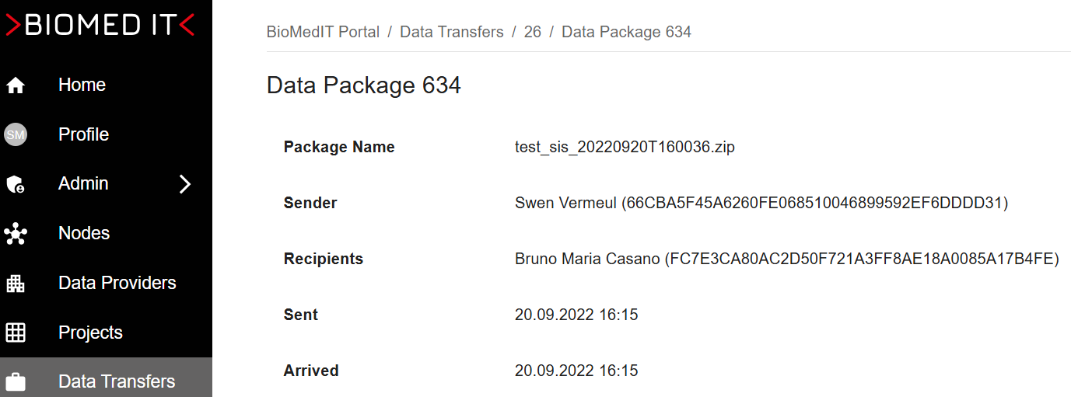



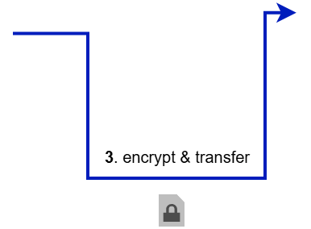
BioMedIT secure data transfer
1. DTR is approved for technical and legal compliance
2. Get Landing Zone access credentials

Slide 20
What questions are we going to address ?
What is a Trusted Research Environment (TRE) and what purpose it serves in academic research ?
Why Switzerland needs a Swiss Trusted Research Environment for research ?
How academic research usecases are enabled on a versatile TRE ?
What challenges one has to face when building a TRE service ?

Slide 21

What challenges one has to face when building a TRE service ?
Researchers,
Data providers,
CISOs,
Lawyers,
Public,
State authorities
Legal and Security compliance
Trust
Usability, Flexibility, Security
System
People
Processes
Data Transfer and Processing Agreements
Secure Service Management

Slide 22

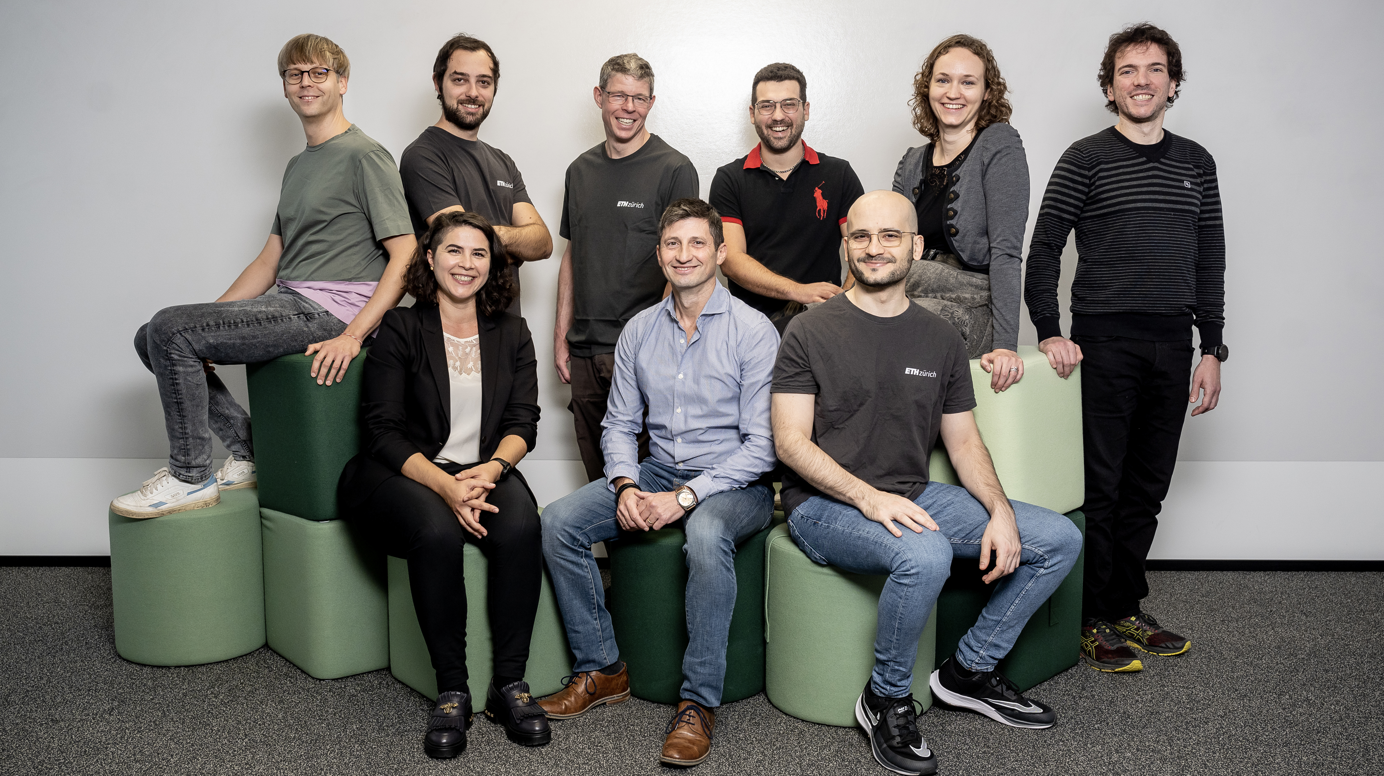
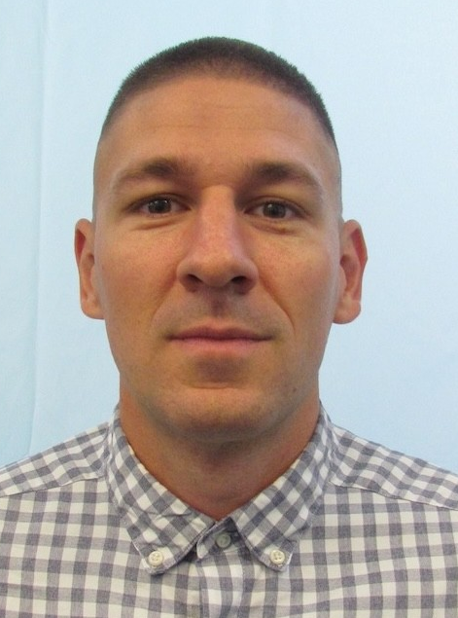
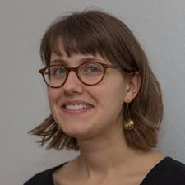
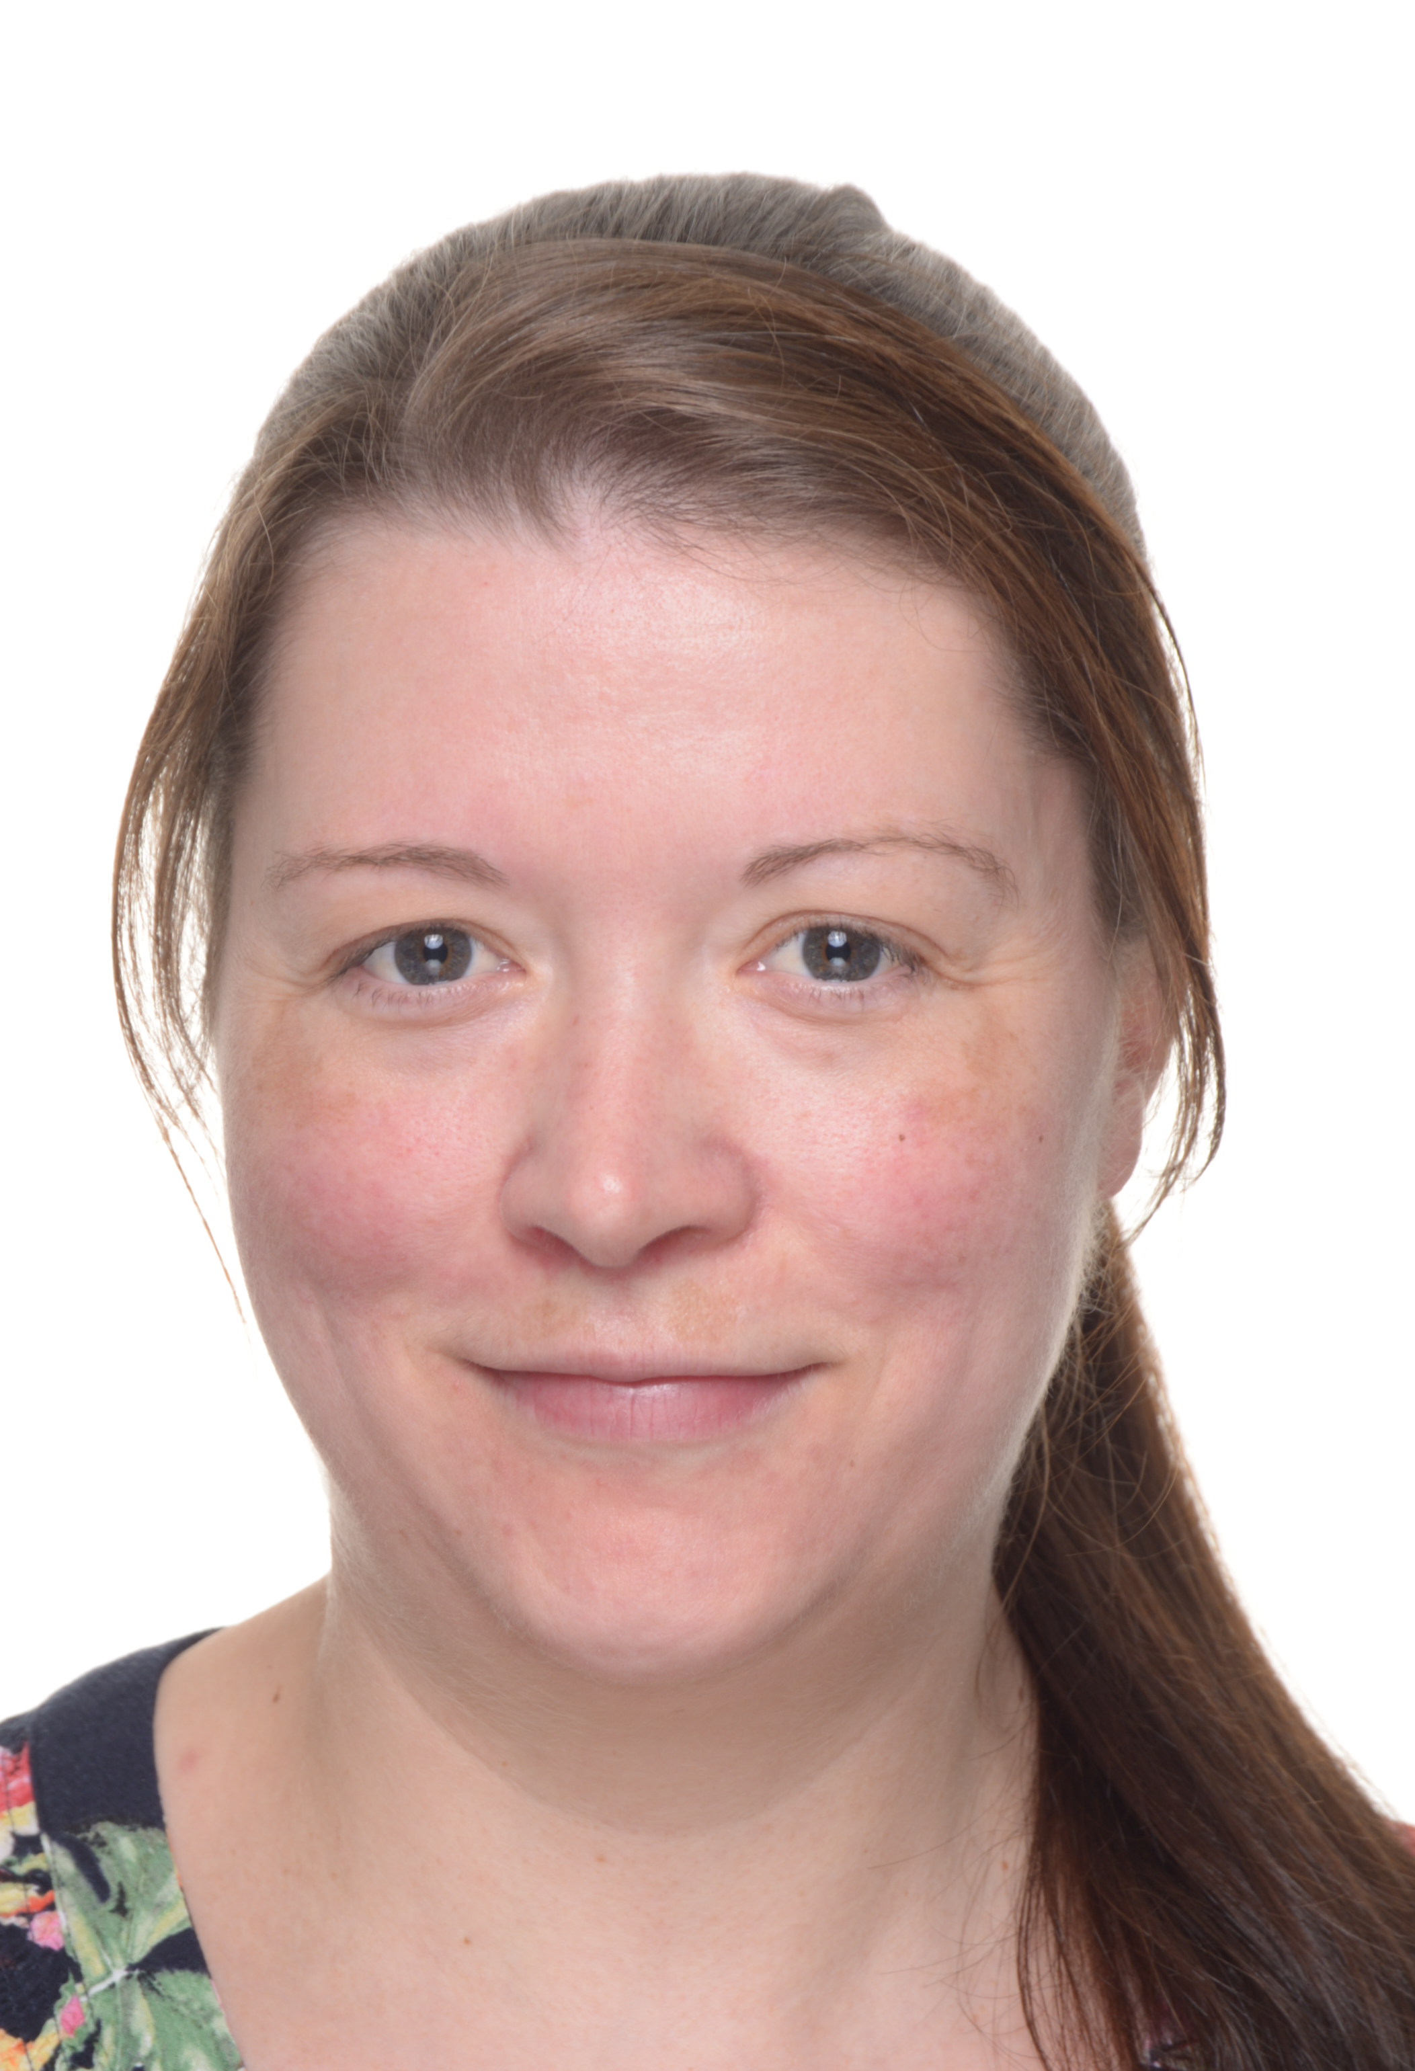
https://unlimited.ethz.ch/display/LeoMed2/
Balasz Unyi

